Slide 1
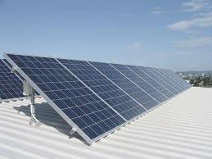
Solar PV System Simulation
Sreejaya, Suman, Vuthy
Fall 2016
DATA 604 - Simulation and Modeling Technique

Slide 2
Introduction
Sreejaya Nair
Suman K Polavarapu
Vuthy Nguy

Slide 3
Problem Description
As awareness of climate change increases, there is a growing trend to reduce reliance on fossil fuel. Renewable energy comes in many forms but we will focus our attention on solar power in this project. We will simulate various aspects of power generation with Solar Photovoltaic system and consider system size, power usage, and cost of obtaining a solar PV system.

Slide 4
Challenges
Variations to the data based on location
Sunlight Amount
Electricity Usage Pattern
Warmer climate – Air Conditioner
Cooler climate – Space Heating
Electricity Cost

Slide 5
Objective: Is it worth if to invest in a solar PV system
At what size will I completely offset my monthly/yearly bill?

Slide 6
Approach
Two basic parts
Solar power Generation
Electricity Consumption

Slide 7
Summary
<CHART> - Panel size Vs yearly costs
For the typical (suburban) New York family, a PV system consisting of XXX number of panels will be needed to virtually offset monthly/yearly electricity costs.

Slide 8
Future Work
More granular level for power consumption simulation
Breakdown of appliances
Family composition
Interactive application to change simulation parameters

